Slide 1
Kubernetes Labs: Workloads

Slide 2
Before we start
Rancher Desktop: Docker desktop alternative with minimal Kubernetes setup
https://rancherdesktop.io/
Kubectl: Kubernetes command line tool
https://kubernetes.io/docs/tasks/tools/install-kubectl-windows/
OpenLens: Open-source Kubernetes IDE
https://github.com/MuhammedKalkan/OpenLens/releases/tag/v6.2.5

Slide 3
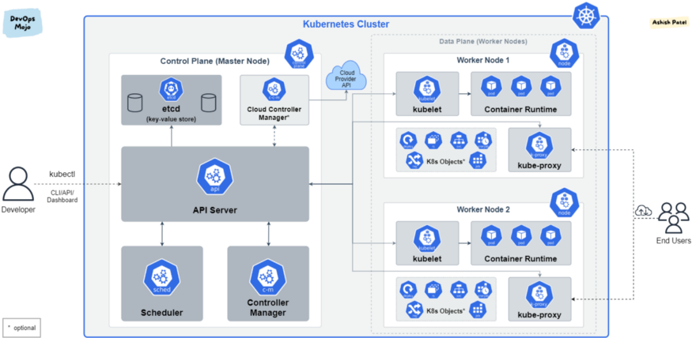
Architecture

Slide 4
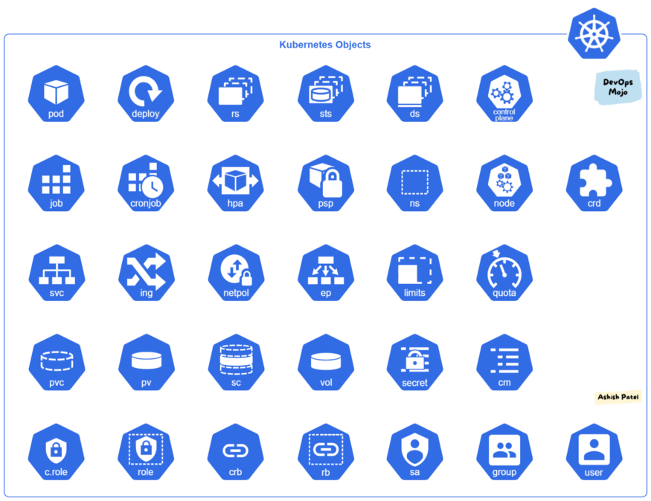
Resources

Slide 5
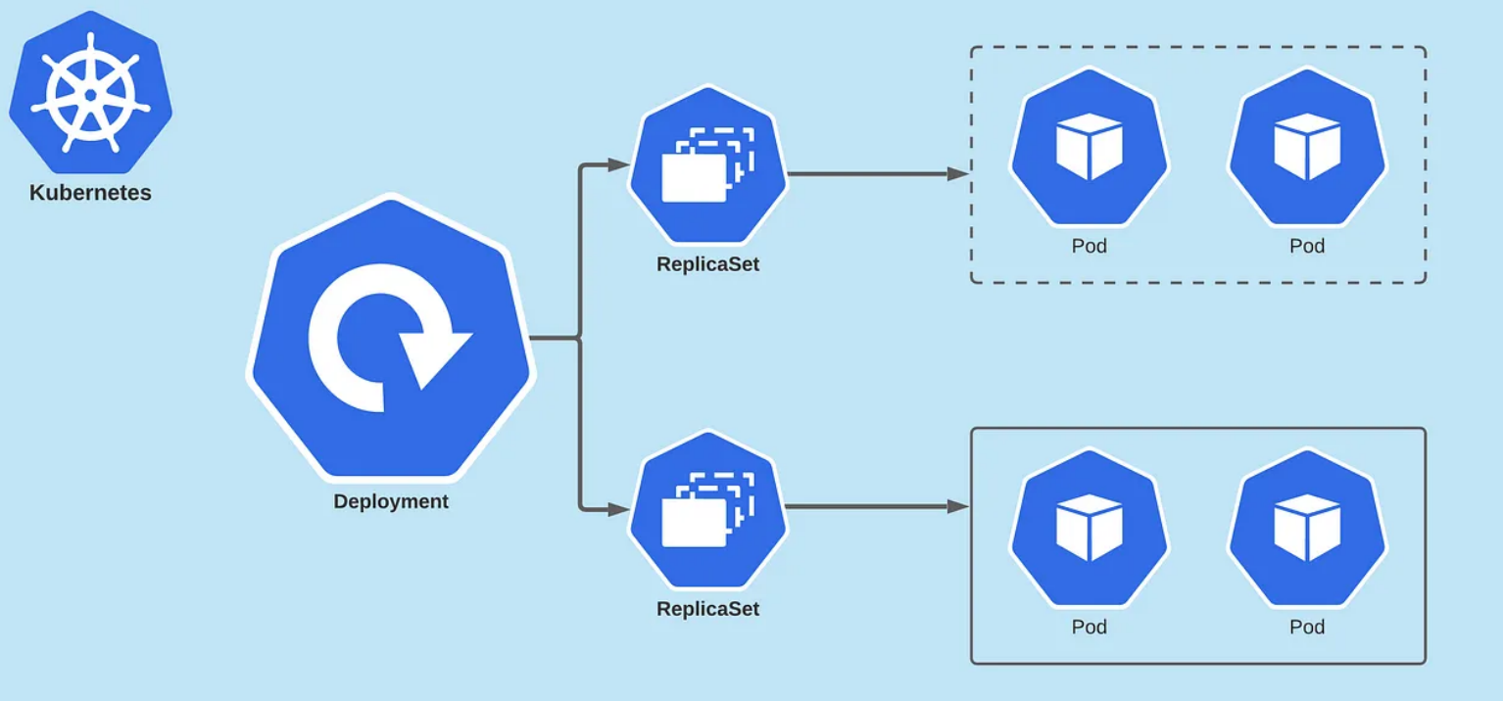
Workloads

Slide 6
Workload Labs
Lab 1: Create a Pod with a single container
Lab 2: Create a ReplicaSet and scale the pods
Lab 3: Create a Deployment
Lab 4: Create a StatefulSet
Lab 5: Create a Job

Slide 7
Assignment
Create a Pod with 2 containers
2 containers should start at the same time. Container 1 will act as a web service and container 2 as a sync between the pod and remote storage. Container 2 will download the required files and exit.
Create a CronJob
The job should periodically check for the file a

